Slide 1

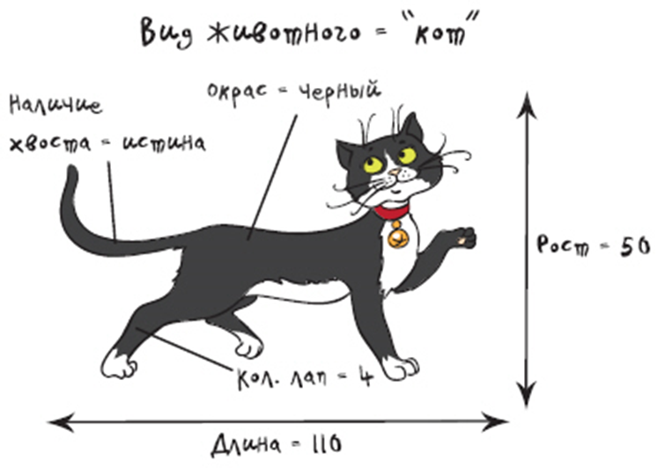
LECTURE 4
class Animal
Cat TOM – instance of class Animal
C# Object Oriented Programming

Slide 2
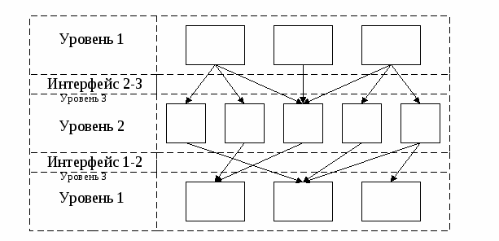
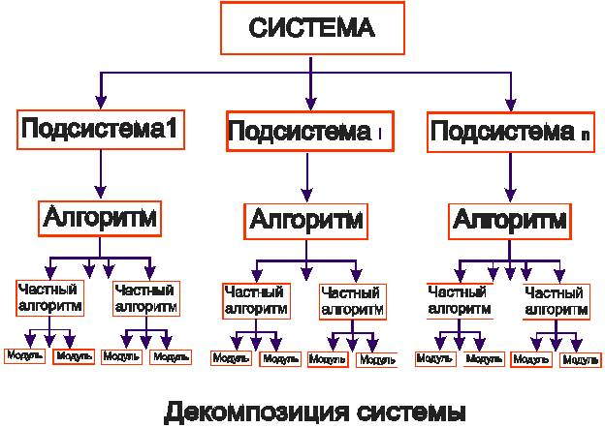
INFORMATION SYSTEMS COMPLICATED ARCHITECTURE DECOMPOSITION

Slide 3
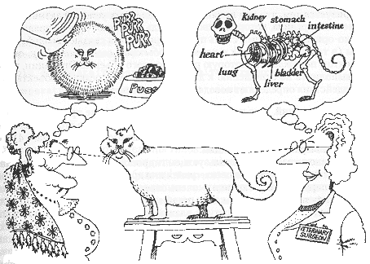
Abstracts
Abstracts – are the subjects or objects that are meaningfull for observer

Slide 4

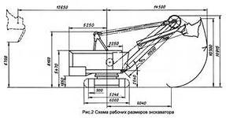
Modelling
Notes:
Карьерный экскаватор и его модель. Нас не интересует экскаватор целиком, только двигатель

Slide 5
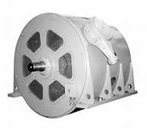
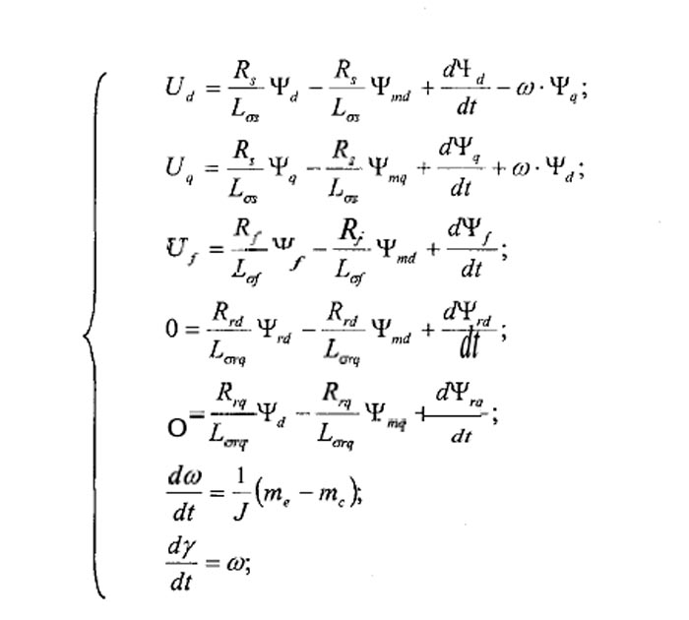
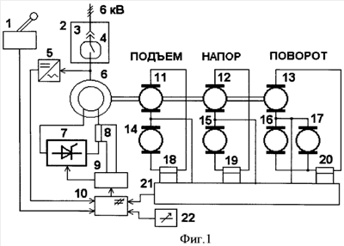
Syncronuous engine
Math model
Notes:
Нас интересует синхронный двигатель экскаватора. Уточнение, не ЦЕНА двигателя, не ТЕХНОЛОГИЯ ИЗГОТОВЛЕНИЯ, не МАТЕРИАЛ, а принцип работы. Поэтому строим модель именно работы, а по ней МАТЕМАТИСЕСКУЮ описательную модель

Slide 6

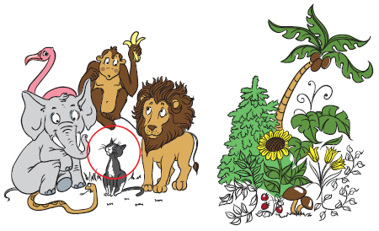
How to create abstract class?
Let’s call all surrounding objects - Classes

Slide 7
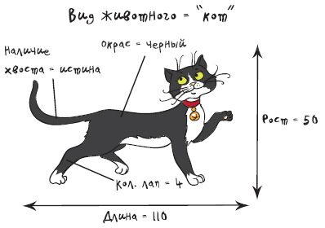
Class Animal
class Animal
{
}
Animal Tom;
Kind of animal = "Cat".
Height = 50 cm (Big cat!).
Length = 110 cm (more likely panter!).
Number of legs = 4.
Color = "Black" .
Has tail = true.
Is mammal = true.

Slide 8
Classes and objects (instances) of class
class Animal
{ string kindOfAnimal;
string name;
int numberOfLegs;
int height;
int length;
string color;
bool hasTail;
bool isMammal;
bool spellingCorrect;
}
Animal Tom;
Tom = new Animal();
Tom.kindOfAnimal = "Cat";
Tom.name = “Tom"; Tom.numberOfLegs = 4;
Tom.height = 50;
Tom.length = 110;
Tom.color = "Black";
Tom.hasTail = true;
Tom.isMammal = true;

Slide 9
Class description
[ Attributes] [Specifications ] class class_name[ : base_class] class_body
The name of class – any literal starting by character (not number).
Class body — the fields and methods of class.
Attributes – are additional information about class.
Specifications define properties of class and accessibility to other elements of program.
Simple example:
class Demo {} // Empty class

Slide 10

ACCESS
class Animal
{
public string kindOfAnimal;
public string name;
public int numberOfLegs;
public int height;
public int length;
public string color;
bool hasTail;
protected bool isMammal;
private bool spellingCorrect;
}
What access property does hasTail have now?

Slide 11


Methods
Addition of two numbers
The function to process data and work with protected fields in defined rule

Slide 12

void Say() { Console.WriteLine(“Myau");
}
…
Animal Tom=new Animal ();
Tom.Say()

Slide 13
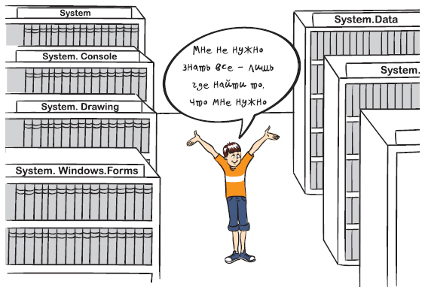
.Net
Almost all necessary common classes and feature can be found in .NET library

Slide 14
Class example
class Monster {
public Monster() // constructor
{
this.name = "Noname";
this.health = 100;
this.ammo = 100;
}
public Monster( string name ) : this()
{
this.name = name;
}
public Monster( int health, int ammo, string name )
{
this.name = name;
this.health = health;
this.ammo = ammo;
}
public int GetName() // method
{ return name; }
public int GetAmmo() // method
{ return ammo;}
public int Health { // property
get { return health; }
set { if (value > 0) health = value;
else health = 0;
}
}
public void Passport() // method
{ Console.WriteLine(
"Monster {0} \t health = {1} \
ammo = {2}", name, health, ammo );
}
public override string ToString(){
string buf = string.Format(
"Monster {0} \t health = {1} \
ammo = {2}", name, health, ammo);
return buf; }
string name; // field
int health, ammo; // field
}

Slide 15
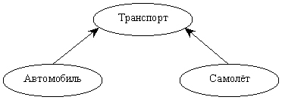
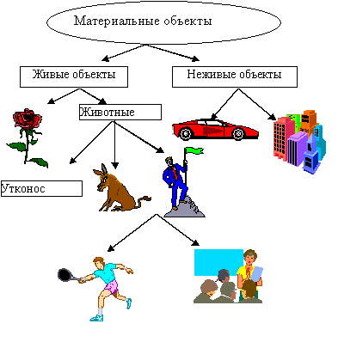
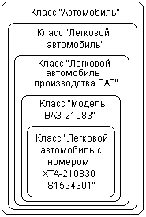
Inheritance

Slide 16



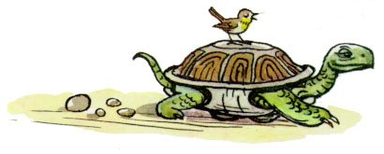
Polymorphism
OOP allows to write agile, extensible and readable programs.
And huge effort in this takes polymorphism, that allows to make same interface to different object types.
Void Move (double s, double v)

Slide 17
OOP Advantages
Usage of terminology that is close to problem area;
Ability to manage huge volume of source codes through encapsulation, simplify code and hide implementation;
Use code many times using Inheritance;
Easy way to modify program;
Ability to create and use objects library.

Slide 18
OOP Disadvantages
Speed decrease because of virtual methods usage

Slide 19
С# Examples

Slide 20
Class description
class <name>{
[ private ]
<description of hidden fields>
public
<description of visible fields>
};
Notes:
Класс можно рассматривать как тип данных, определяемый пользователем. В классе задаются свойства и поведение какого-либо предмета или процесса в виде полей данных (аналогично структуре) и функций для работы с ними. Создаваемый тип данных обладает практически теми же свойствами, что и стандартные типы (напомним, что тип задает внутреннее представление данных в памяти компьютера, множество значений, которое могут принимать величины этого типа, а также операции и функции, применяемые к этим величинам).
Существенным свойством класса является то, что детали его реализации скрыты от пользователей класса за интерфейсом. Интерфейсом класса являются заголовки его открытых методов. Таким образом, класс как модель объекта реального мира является черным ящиком, замкнутым по отношению к внешнему миру.
Данные класса называются полями (по аналогии с полями структуры), а функции класса - методами. Поля и методы называются элементами класса. Описание класса в первом приближении выглядит так:

Slide 21
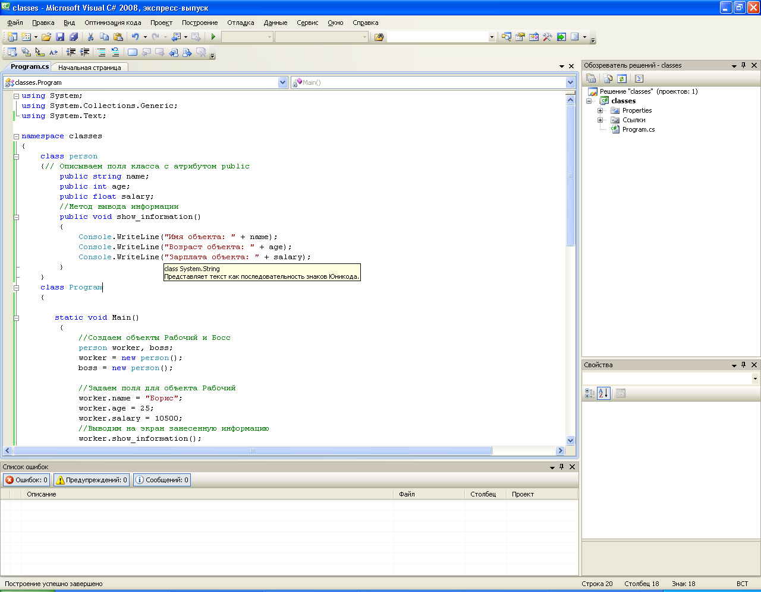
Example 1. Person class.
1.1. fields name, age, salary.
1.2. method – show_information.

Slide 22
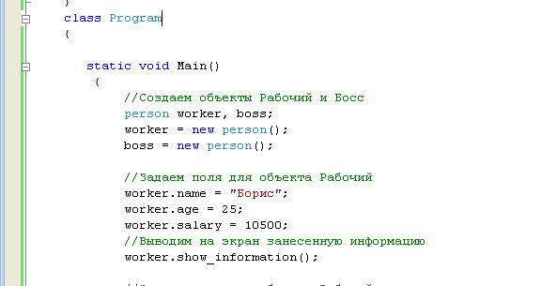
Create of class instances

Slide 23
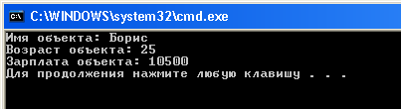
Output:

Slide 24
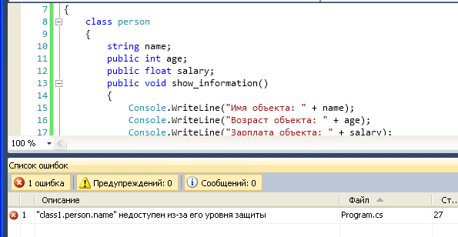
Access rule specification
Public and Private

Slide 25
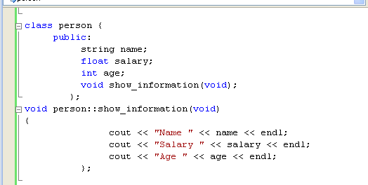
Implementation of method can be outside of the class description

Slide 26
Constructors
For creating of object with initialized parameters.
The name of constructor is same as class name.
Constructor doesn’t have return value.
During runtime when object is created constructor is called.
You can create As many constructors as You like

Slide 27
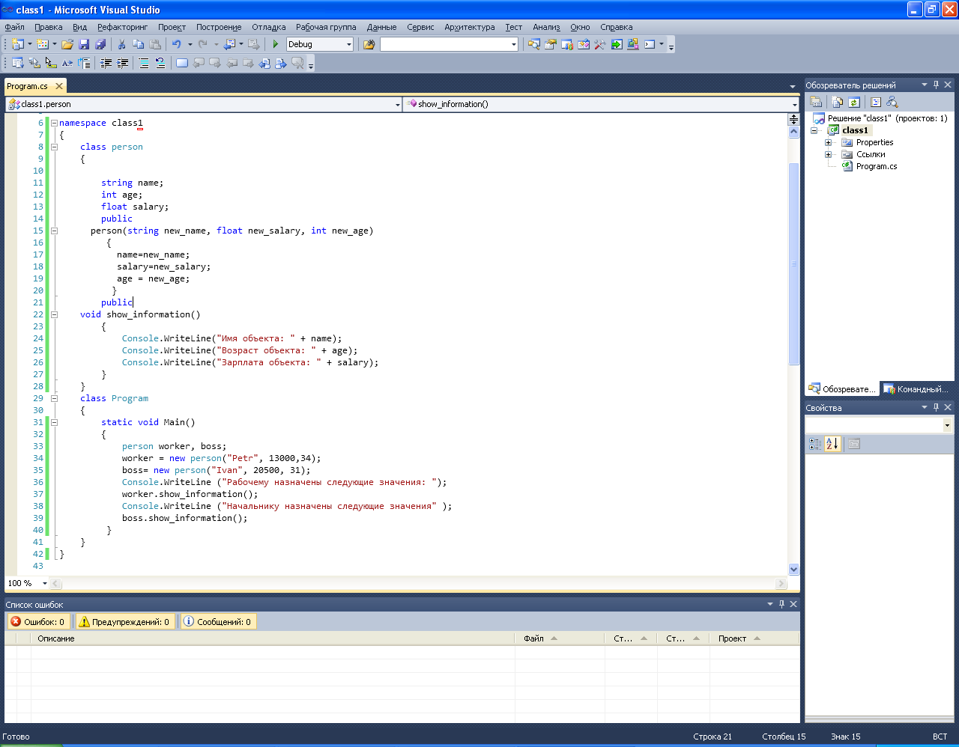
Person constructor:

Slide 28
Now it is possible to create objects like this.

Slide 29
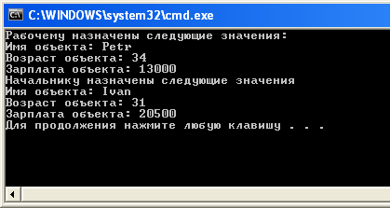
Result:

Slide 30
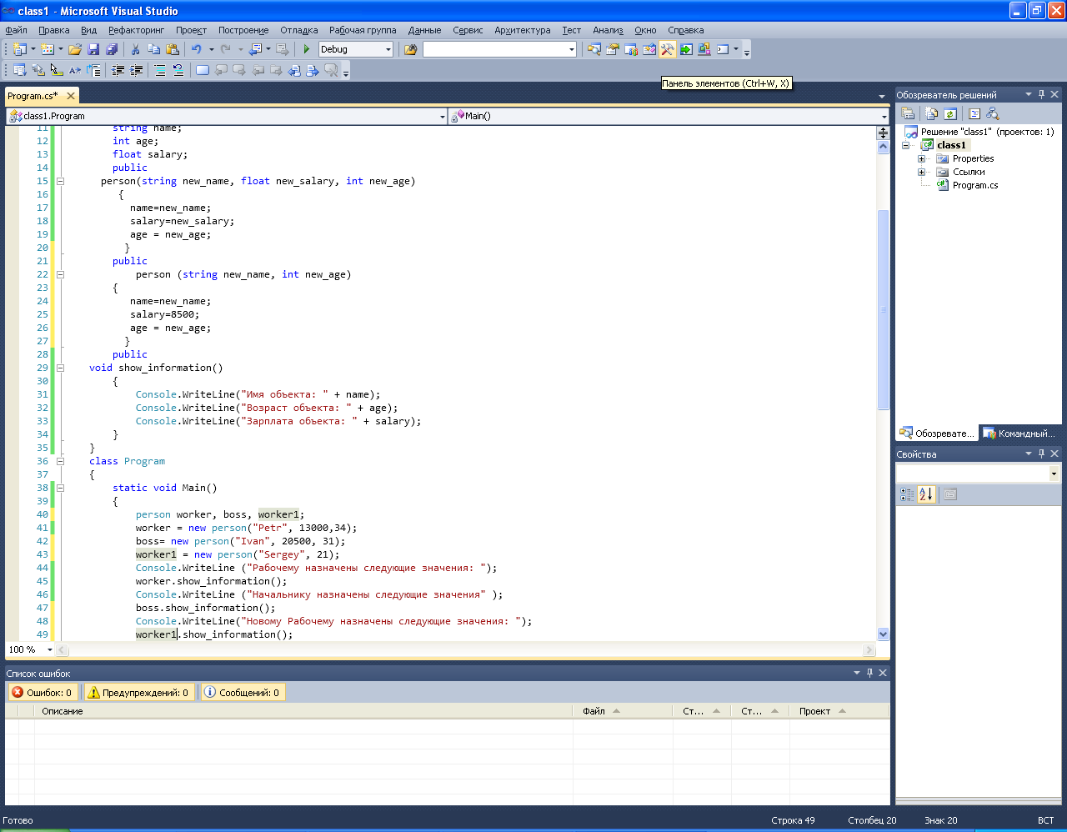
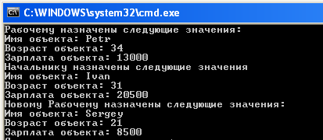
Default constructors

Slide 31
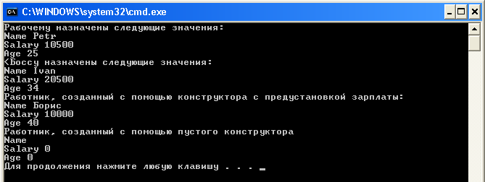
Constructor with empty fields

Slide 32
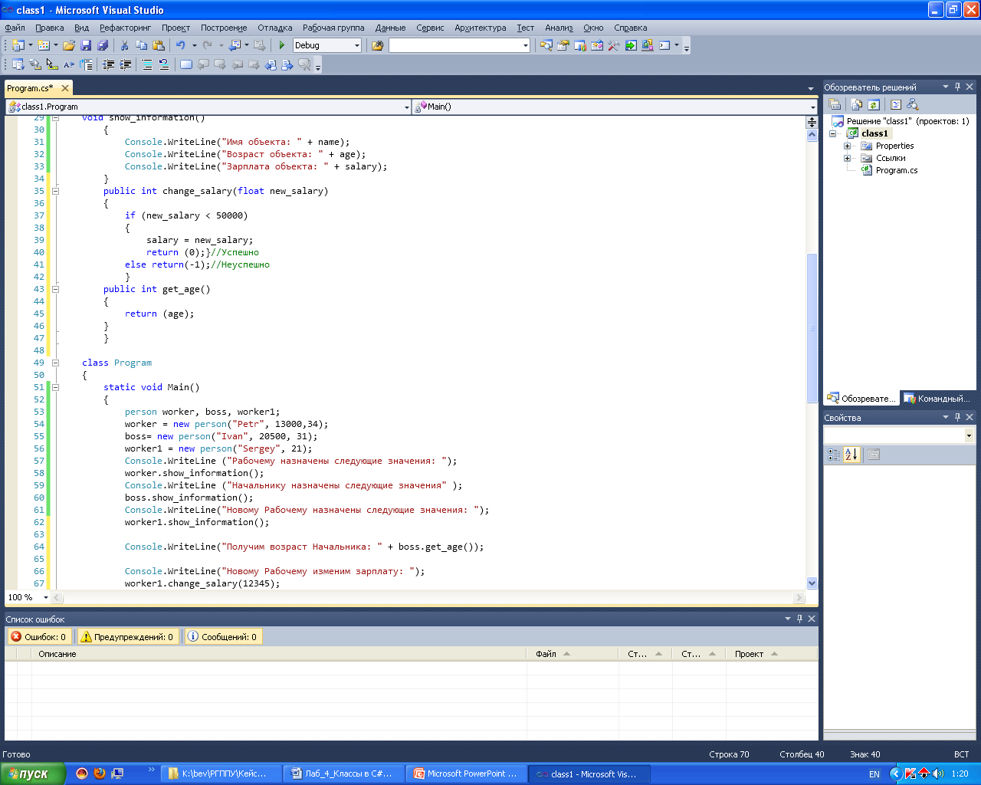
Access to the private fields
Encapsulation principles.
Editing fields are possible through methods.
Methods can be like:
change_salary;
get_age;

Slide 34
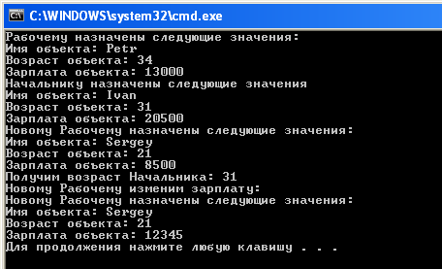

Slide 35
C# Specifics
Operators overload
Properties
Indexers
ref and out parameters
Params in methods as attribute
Attributes of classes
Methods Extension

Slide 36
Operators overload
In an object oriented programming language like C#, operator overloading provides a much more natural way of implementing the operations on custom types.
Suppose that we have a class created for Complex number and we want to perform all the arithmetic operations on this type.
One way to do this is by having functions like Add, Subtract inside the class and have the functionality.
Another way is to actually have the overloaded version of operators to act on this type.

Slide 37
The operator function should be a member function of the containing type.
The operator function must be static.
The arguments of the function are the operands.
The return value of the function is the result of the operation.
The operator function must have the keyword operator followed by the operator to be overridden.

Slide 38
// Declare which operator to overload (+), the types
// that can be added (two Complex objects), and the
// return type (Complex):
public static Complex operator +(Complex c1, Complex c2)
{
return new Complex(c1.real + c2.real, c1.imaginary + c2.imaginary);
}

Slide 39
Overloading the Binary operators
Binary operators function will take 2 arguments and return a new object of the Containing type.

Slide 40
public static Rational operator +(Rational rational1, Rational rational2)
{
int resultingDenominator = rational1.denominator * rational2.denominator;
int resultingNumerator = rational1.numerator * rational2.denominator +
rational1.denominator * rational2.numerator;
return new Rational(resultingNumerator, resultingDenominator);
}

Slide 41
Rational r1 = new Rational(3, 2);
Rational r2 = new Rational(2, 3);
Rational result = null;
// Testing + operator on types
result = r1 + r2;

Slide 42
Overloading the Unary operators
To overload the unary operators, we need a function taking only one argument of the containing type. The important thing in case of overloading unary operators is that we should not create a new object but instead change the value of the object being passed to us and return it.

Slide 43
public static Rational operator ++(Rational rational1)
{
rational1 += 1;
return rational1;
}

Slide 44
Overloading the Relational operators
Relational operators like < and > can also be overloaded as functions taking two arguments. The important thing to note is that we need to overload relational operators in pairs i.e. if I am overloading < operator than I will have to overload > operator too. Same is true for (<=, >=) and (==, !=) operators.

Slide 45
public static bool operator < (Rational rational1, Rational rational2)
{
return rational1.Value < rational2.Value;
}
public static bool operator >(Rational rational1, Rational rational2)
{
return rational1.Value > rational2.Value;
}
//Usage
static void Main(string[] args)
{
// test relational operator
Console.WriteLine(r1 > r2);
}

Slide 46
Other important thing to note is while implementing the equality i.e. == operator. If we are overloading ==operator then we need to implement!= operator too(as discussed above). Also, we need to override the Equalsand GetHashCode functions so that if our object returns true for == then it should return true for Equals function too and should return the same value from GetHashCode().

Slide 47
public static bool operator ==(Rational rational1, Rational rational2)
{
return rational1.Value == rational2.Value;
}
public static bool operator !=(Rational rational1, Rational rational2)
{
return rational1.Value != rational2.Value;
}
public override bool Equals(object obj)
{
Rational r = obj as Rational;
if (r != null)
{
return r == this;
}
return false;
}
public override int GetHashCode()
{
return Value.GetHashCode();
}

Slide 48
Overloading the Conversion operators
We might also need to implement conversion operators sometimes so that our type can safely be converted to and from other types. We can define the conversion operators as implicit or explicit. In case of implicitconversion the user will not have to explicitly type cast our type to target type and our conversion operation will work. In case of explicit conversion the user will have to explicitly cast our type to target type to invoke our conversion operation. If the casting is not performed it will give a compile time error.

Slide 49
public static implicit operator Rational(int i)
{
// since the rational equivalant of an int has 1 as denominator
Rational rational = new Rational(i, 1);
return rational;
}
public static explicit operator double(Rational r)
{
double result = ((double)r.numerator) / r.denominator;
return result;
}
static void Main(string[] args)
{
// implicit convertion from int to rational
Rational ri = 3;
//explicit conversion from rational to double
double value = (double)ri;
}

Slide 50
Operators | Overloadability
+, -, !, ~, ++, --, true, false | These unary operators can be overloaded.
+, -, *, /, %, &, |, ^, <<, >> | These binary operators can be overloaded.
==, !=, <, >, <=, >= | The comparison operators can be overloaded (but see note below).
&&, || | The conditional logical operators cannot be overloaded, but they are evaluated using & and |, which can be overloaded; see 7.11.2 User-defined conditional logical operators.
[] | The array indexing operator cannot be overloaded, but you can define indexers.
() | The cast operator cannot be overloaded, but you can define new conversion operators (see explicit and implicit).
+=, -=, *=, /=, %=, &=, |=, ^=, <<=, >>= | Assignment operators cannot be overloaded, but +=, for example, is evaluated using +, which can be overloaded.
=, ., ?:, ->, new, is, sizeof, typeof | These operators cannot be overloaded.

Slide 51
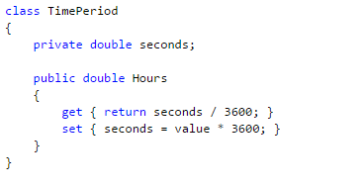

Properties

Slide 52
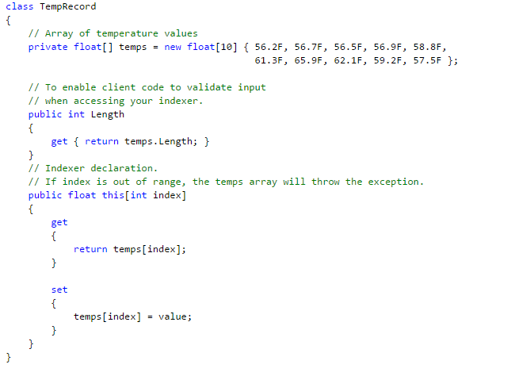
Indexers

Slide 53
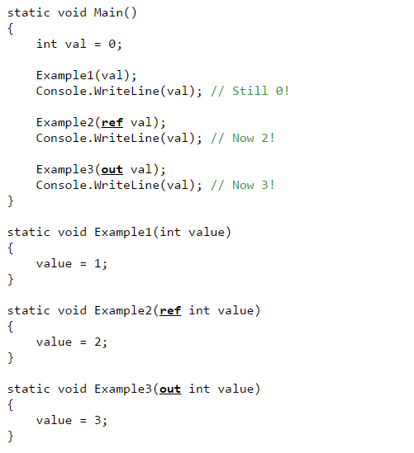
Ref and Out parameters

Slide 54
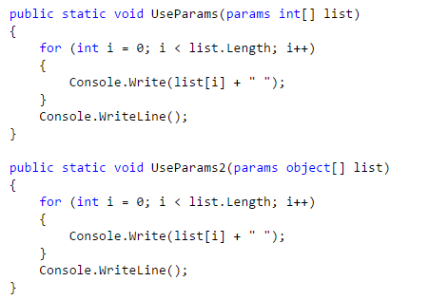



Params keyword in methods as attribute

Slide 55

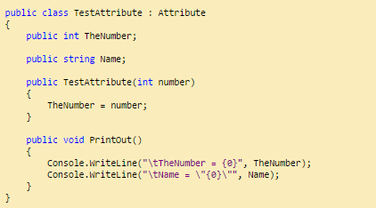
Attributes of classes
Essentially attributes are a means of decorating your code with various properties at compile time.

Slide 56
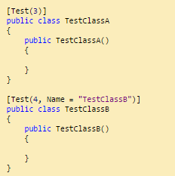

Slide 57
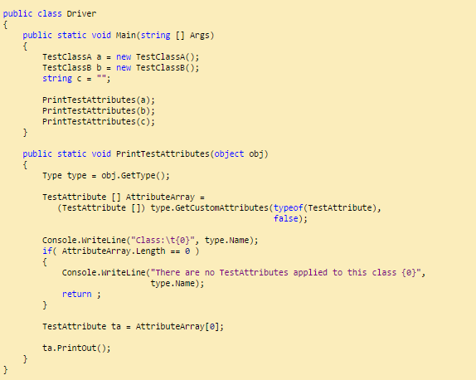

Slide 58
Attributes can be attached to virtually everything, classes, methods, fields, properties, parameters in methods, return values of methods; having at least a basic knowledge of what attributes are and how to use them is extremely helpful in the long run.

Slide 59
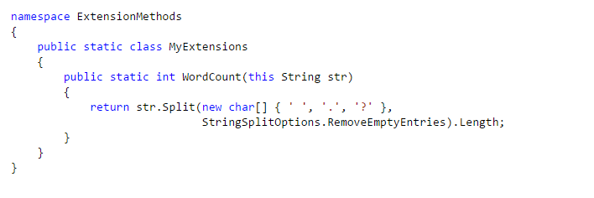


METHODS EXTENSION

